Slide 1
LSS Projects

Slide 2
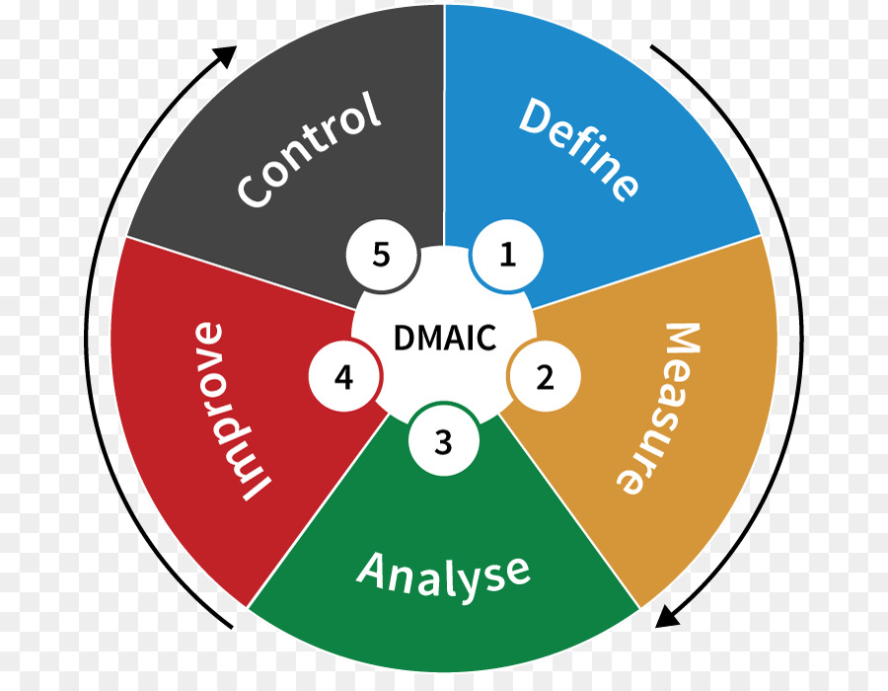
DMAIC

Slide 3
DMAIC Process improvement roadmap
DMAIC roadmap
Define 1 Define and Scope project
2 Define defect and CTQs
3 Plan and document project
Measure 4 Evaluate measurement system
5 Establish baseline
6 Set improvement goals
Analyze 7 Map process and identify inputs
8 Isolate key inputs
9 Develop Y=f(X) function
Improve 10 Determine optimum settings
11 Implement proposed improvement
12 Validate proposed improvement
Control 13 Implement control strategy
14 Close out project

Slide 4
DEFINE 1 – Define and scope project
Problem Description:
What is wrong, how does it affect the customer, what is the pain for the organization? Is it a priority, so in line with top-down priorities?
Add picture or drawing to explain
Objectives:
What do we want to achieve?
Helicopter view description.

Slide 5
DEFINE 1 – Define and scope project
Target:
Describe the quantified, measurable result (not the solution!).
What is the required timing?
In Scope
What are the boundaries of the process to analyze; what are you allowed to change?
Out of Scope:
What not . . . ?
Deliverables:
What evidence to put at the table to show that targets metrics are met?
This is the key element in the agreement with the champion
Hard Benefits:
Summarize the calculation to shows that this is a ‘major cost saving or cost avoidance, in keuro/year. Upon need add a separate sheet
Soft Benefits:
Any nice additional benefits, like customer satisfaction, learning Lean Six Sigma

Slide 6
DEFINE 2 - Define defects and CTQs
Start from customer perspective
Customer specification
‘OK for customer’
Internal specification
This can be a vague description of the critical variable
VOC
CTQ ext
Variable: ………
Target: …………
Specifications: ……
Describe the measurable variable and specifications as required by the customer.
Variable: ………
Target: ……
Specifications: …………
Describe the measurable variable and specifications as defined in own organization. Can be different from the CTQext, but must have a known/proven relation with CTQext.
CTQ int
High level, describe until highest level measurable CTQ int. (the project target)
Legend: solid line: proven relation
dotted line: relation tbd.
grey box: out of scope
white box: potential CTQ, or group of CTQs

Slide 7
DEFINE 3 – Plan and document project
Project Team
Supplier:
Champion:
User:
MBB:
who provides resources
driving for success
will benefit from the results
coach for methodology
Project leader (Belt):
Actively involved
members in team meetings
Name:
Role:
Responsibility:

Slide 8
DEFINE 3 – Plan and document project
SIPOC is mandatory for process improvement
For design improvement: visualize product problem area
SIPOC Process Map
Supplier: | Inputs:
Process:
Outputs: | Customers:
‘Process’
Controllable variables
+ specs
Main noises
Output variables
Standard Operating Procedures
If helpful show below detailed steps on the process
Step 1
Step 2
Step 3
Step 4
Step 5

Slide 9
MEASURE 4 – Evaluate measurement system
For Target internal CTQs
Measurement error
Evaluate whether measurement error for the CTQ int, described in the target is good enough for this project.
e.g. reference data, GR&R, bias, attribute agreement, etc.
CTQ int
Conclusion:

Slide 10
MEASURE 5 – Establish baseline
How is the situation on the CTQs in the beginning of the project? (measured with the known error)
e.g. results of capability & performance study
If historical measurement error is unknown, add a note.
Visualize if possible, for instance in time.
Conclusion:

Slide 11
MEASURE 6 – Set improvement goals
Final Target
Evaluate whether the original target(s) are realistic. If necessary describe the rational why the targets are being adjusted.
Conclusion:

Slide 12
ANALYZE 7 – Map process and identify inputs
Process Map
Input variable 1 Input variable 2
.............
Use this format for process improvement (in case of Lean project use a VSM)
For design improvement use Boundary Diagram or Parameter Diagram, for the applicable function(s)
(process
step 1)
Input variable 1 Input variable 2
.............
….
Input variable 1 Input variable 2
.............
….
Input variable 1 Input variable 2
.............
(process
step x)
Output variable 1 Output variable 2
Output variable 3
.............
These should be the CTQs
Conclusion:

Slide 13
ANALYZE 7 - Map process and identify inputs
Create this diagram to complete and categorize the list of inputs
Ishikawa Diagram
Measurement
Machine
Men
Defect
Methods
Environment
Materials
Conclusion:

Slide 14
ANALYZE 8 – Isolate key inputs
If a large number of inputs is identified, it is important to limit the analysis to a small set of important (key)inputs.
Tools include: Cause & effect matrix, screening (DOE), FMEA
Conclusion:

Slide 15
ANALYZE 9 – Develop Y=f(X) function
Tools: Anova, Regression, DOE, simulation, etc
Conclusion:

Slide 16
IMPROVE 10 – Determine optimum settings
DOE, simulation, etc
Conclusion:

Slide 17
IMPROVE 11 – Implement proposed improvement
Show a list of implemented improvements
Conclusion:

Slide 18
IMPROVE 12 – Validate proposed improvement
Show the verification run compared to baseline that the Define conditions will be met.
Conclusion:

Slide 19
CONTROL 13 – Implement control strategy
Open actions
….
….
Documentation
Component drawings
Manufacturing specifications
Control plan
Engineering reports
FMEA
..
Roles & responsibilities
..
Actions and owners necessary to finish this project
How is assured that all information is well documented for future success
What are the key roles & responsibilities to assure continued success

Slide 20
CONTROL 14 – Close out project
Conclusions
….
Recommendations
….
….
Lessons learned
….
….
Relate this to the project objective, targets and deliverables
For follow-up, next steps, or next projects
For colleagues, others

Slide 21
CONTROL 14 – Close out project
The realized benefits of this projects are:
Summarize final total savings, average per year
Champion:
Date, Name & Signature
-
Controller:
Date, Name & Signature
-
BB
-

